Slide 1


24-HOUR FORECAST
19-10-2022 @ 1200 UTC
Department of Meteorology and Climate Science,
KNUST

Slide 2
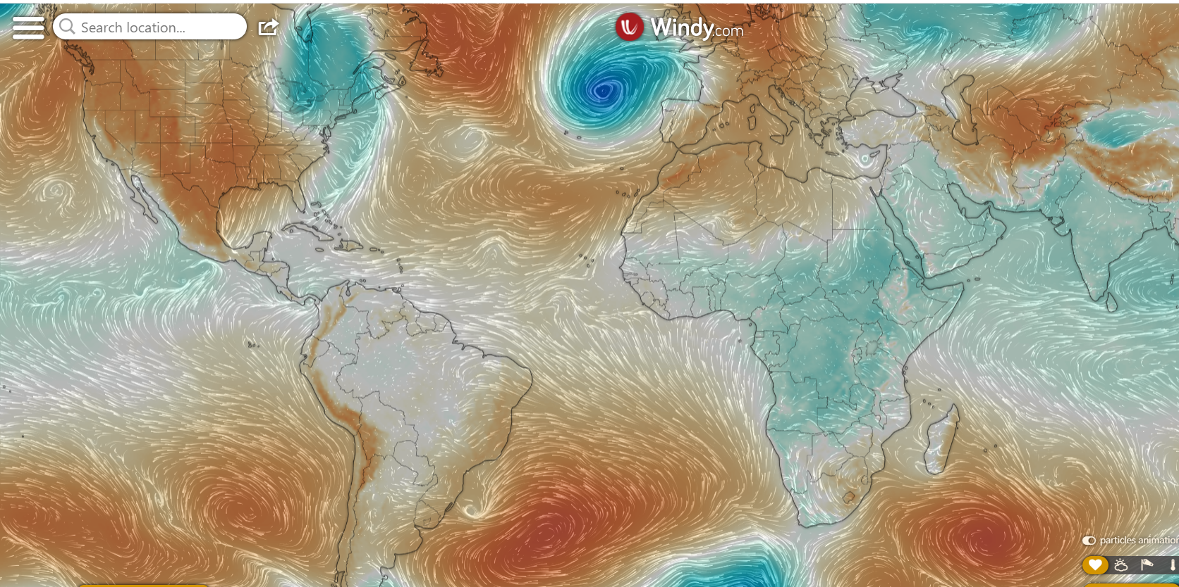
PRESSURE SYSTEMS @0000
992hPa
1032hPa

Slide 3
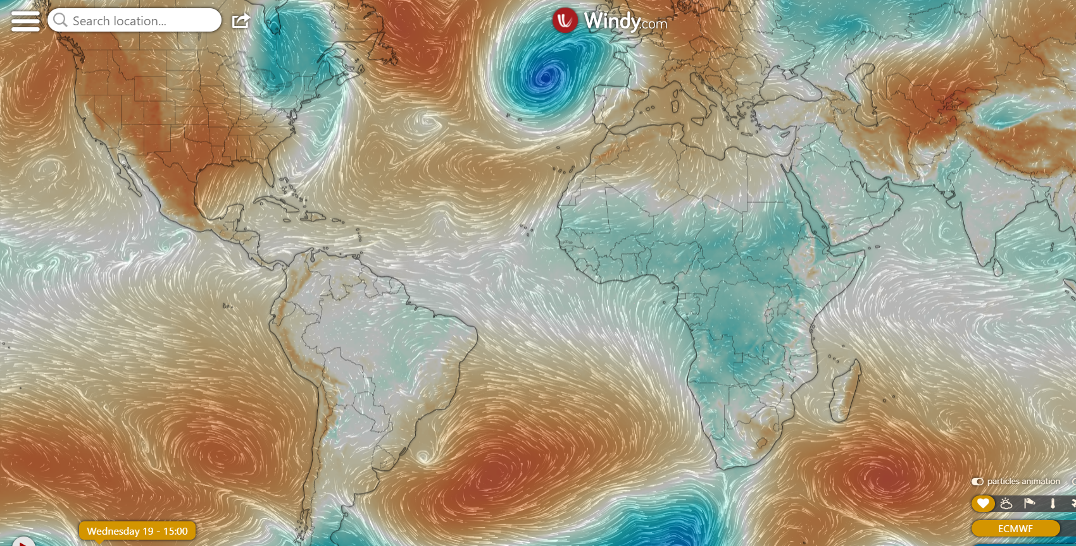
@ 1500
978hPa
1032hPa

Slide 4
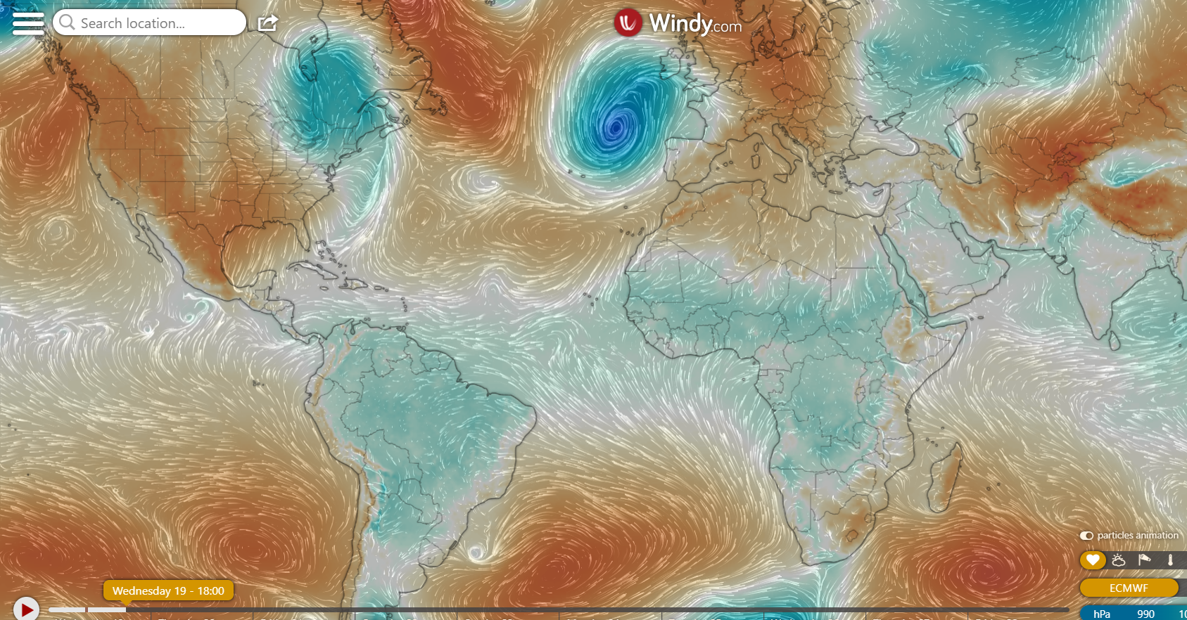
@1800
983hPa
1031hPa

Slide 5
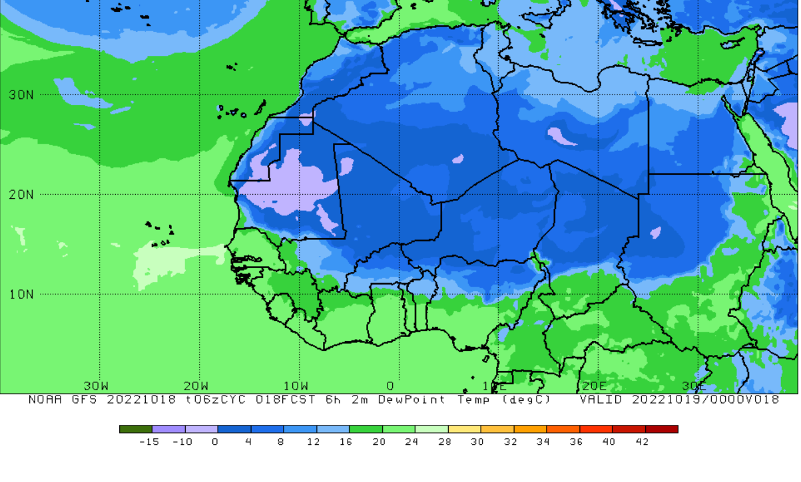
ITD POSITION
@ 0000
11N

Slide 6

@ 0600
11.5N

Slide 7
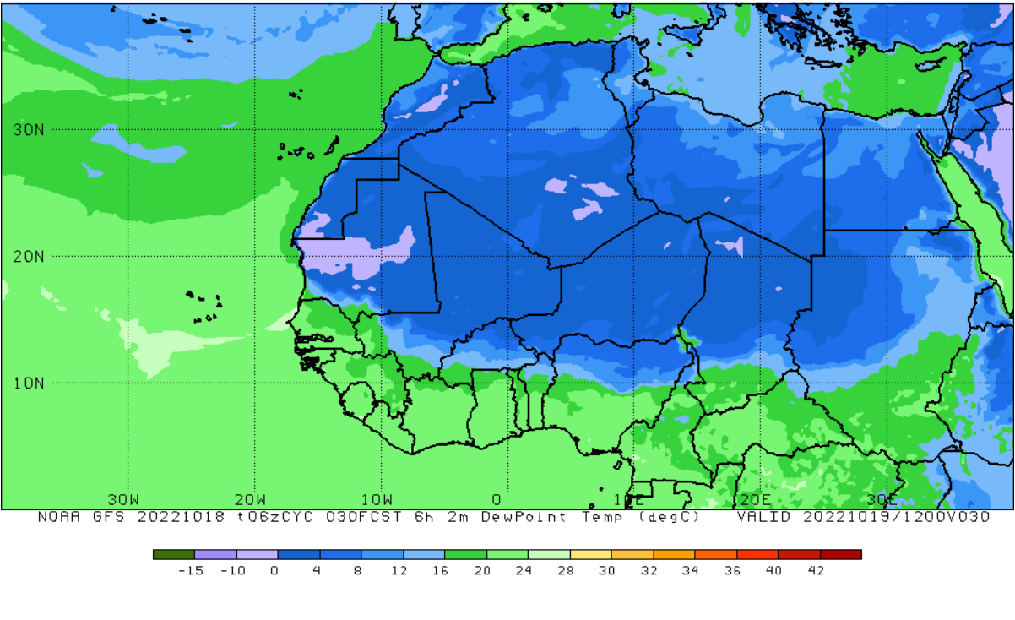
@ 1200
11.5N

Slide 8
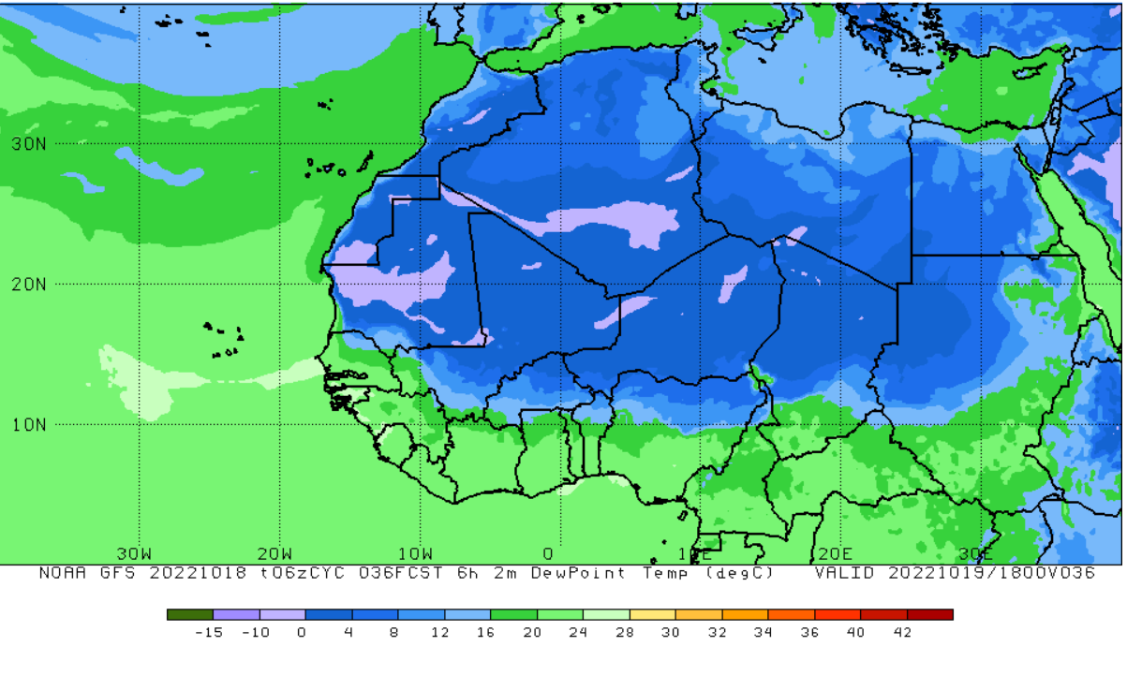
@ 1800
10.5N

Slide 9
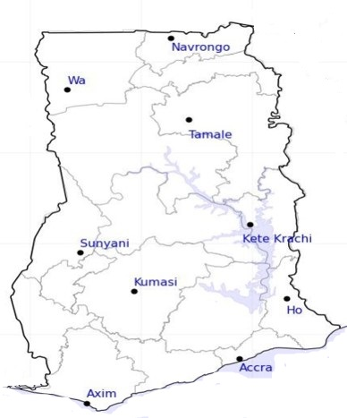

65%
24-HOUR FORECAST
19-10-2022 @ 1200 UTC
73%
RH AT DAY
73%
72%
74%
81%
64%
75%
80%
83%

Slide 10
73%
24-HOUR FORECAST
19-10-2022 @ 1200 UTC
54%
RH AT NIGHT
84%
82%
83%
96%
93%
90%
89%
88%

Slide 11
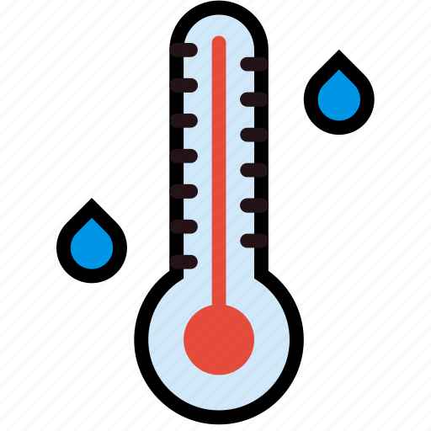
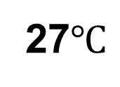
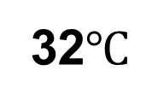
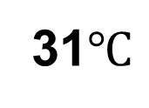
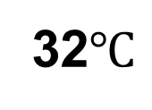
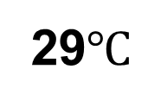
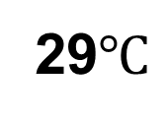
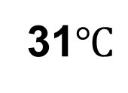
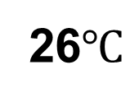
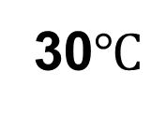
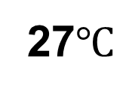
32$℃$
24-HOUR FORECAST
19-10-2022 @ 1200 UTC
30$℃$
TEMPERATURE AT DAY
31$℃$
32$℃$
31$℃$
29$℃$
29$℃$
27$℃$
27$℃$
26$℃$

Slide 12
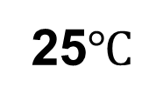

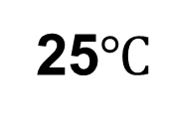

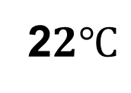
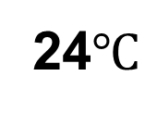
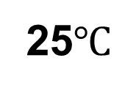
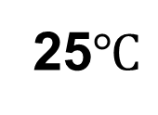
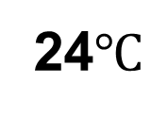
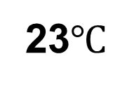
25$℃$
24-HOUR FORECAST
19-10-2022 @ 1200 UTC
24$℃$
TEMPERATURE AT NIGHT
25$℃$
$$23℃$$
25$℃$
2$2℃$
24$℃$
$$23℃$$
23$℃$
25$℃$

Slide 13

GENERAL OUTLOOK
24-HOUR FORECAST
19-10-2022 @ 1200 UTC
PROBABILITY OF RAINS
20%

Slide 14
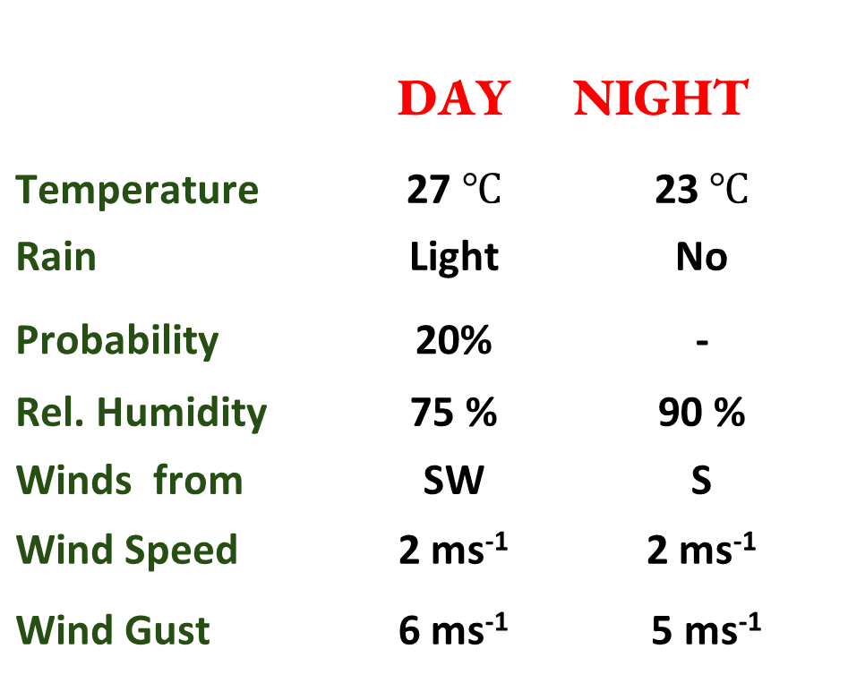

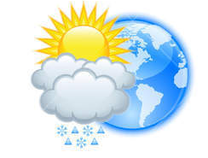






Meteorology and Climate Science
Department of Physics, KNUST
24-HOUR FORECAST
19-10-2022 @ 1200 UTC
Forecast Summary (KUMASI)
Rain
Wind
Dust
 | DAY | NIGHT
Temperature | 27 $℃$ | 23$℃$
Rain | Light | No
Probability | 20% | -
Rel. Humidity | 75 % | 90 %
Winds from | SW | S
Wind Speed | 2 ms⁻¹ | 2 ms⁻¹
Wind Gust | 6 ms⁻¹ | 5 ms⁻¹
Low risk
Be aware
Be Prepared
Take Action
SUNSET: 05:57 PM SUNRISE: 05:53 AM

Slide 15


